Slide 1
Sourcing

Slide 2
Necessary Elements to Research
Understanding Your Territory
Knowing their pace and personality
Building credibility
Understanding the Prospect’s Industry
Trends
Business Processes
What IT means for the business
Understanding the Prospect’s Company
Financial Health
Public or Private
Understanding the Personal Drivers of your prospects

Slide 3
Specific Information to Prepare
Company Information
Including Use Cases / Metrics
Account Mapping
IT Department Staff Mapping
Direct Dials and Emails
Scope of IT Environment
Partner Information
Prior VMTurbo Engagements
Notes:
Any other information that you guys feel is necessary to include?
1. Company information/ account mapping (vertical, employees, etc. – profile) > Kevin Ollquist xls
2. Use case / metrics gathering (what from Wiki/GC is relevant or recommended to use on prospecting calls)
3. IT department staff mapping (# of staff, names and titles, reporting structure, etc.)
4. Direct dial phone #s
5. IT environment survey (either via web or calling the account… gather info on #vms, vendors) – use career page and LI profiles
6. Partner info (call and ask prospect… Excel lookup spreadsheet)
7. Geo mapping (physical locations, # of locations, etc.)
8. Account plan (recommended talk tracks, recommended “first call” person, etc.)

Slide 4
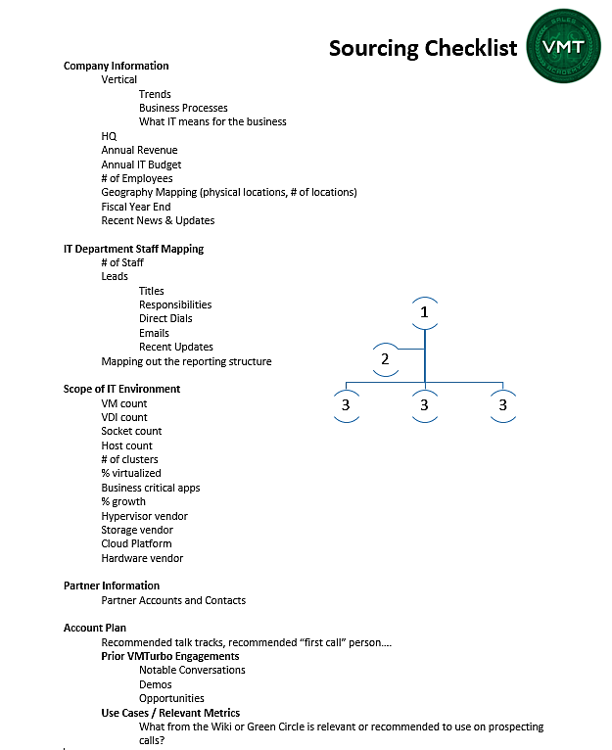

Slide 5
Why is this important?
Allows you to identify and focus on top accounts
Utilizing your time in the office more efficiently when you dial
Higher conversion of conversations to scheduled demos
By learning how to research and map out an account, this will help you understand how to own a territory in preparation for being an Account Executive!

Slide 6
Review IT Organizational Chart

Slide 7
VP of IT
Director of Security
Director of IT Application Delivery
Director of Enterprise Architecture
CIO
IT Security Manager
IT Security Specialist
Senior Enterprise Architect
Manager of Application Development
Manager Network Services
Infrastructure Manager
Senior Systems Administrator
Application Analyst
Senior Application Developer
Help Desk Supervisor
Senior Systems Engineer
Network Engineer
Director of Infrastructure
Systems Administrator
Storage Specialist
IT Specialist
Senior Database Administrator
Executive Assistant
CTO
Typical IT Org Chart
Notes:
Typical It departments are complex and have many different departments with many different roles.
Every IT department is different based on the needs of the business but most have some organization similarities
There are many way that VMTurbo can help but the best area to target is the infrastructure and architecture teams

Slide 8
How to Leverage Each Level
CIO/VP
Use to identify key goals/objectives for the department.
IT Director
Are the best target for VMTurbo
Manager / Team Lead
Are normally the most senior technical staff
Use their name as leverage to get in touch with Directors/Managers
Have both technical and business influence and will be involved in most software purchases
May have some budget information/influence
Have the ear of the IT director
Sys Admins
Help Desk
Easy to get in touch with
Easiest to get in touch and most willing to speak
Great source for information about the environment and structure of organization
Have very little influence on purchasing
Great source of information about the department
Can be used to get names, direct dials, email addresses, etc.
Notes:
What do you guys leverage from these levels or from specific roles?
ADD IN HELP DESK
LOWER LEVEL ROLES – architect, etc.
INTERACTIVE PART – what can you leverage from each role?
You have to ask role and can you help me understand your role
What will resonate between the three roles?
Admin – maintain and interpret the data – basic up-keep – don’t care about purchasing
Engineer – fix and understand the processes **Don’t underestimate the engineer – like the plumber – can take action
Architect – design

Slide 9




Tools to Complete Your Research

Slide 10
Leveraging What’s Already in SFDC
Notes:
***Pull up Salesforce and go over the account, contact and lead pages

Slide 11
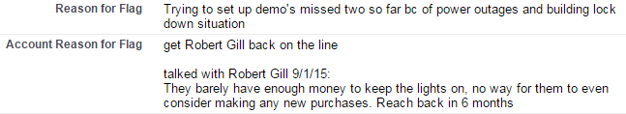
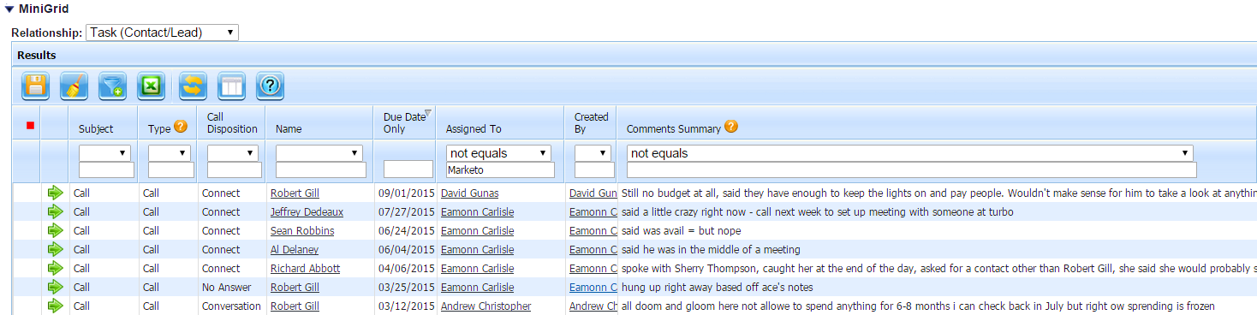
Prior VMTurbo Engagements
Notable conversations
Demos
Opportunities
Details in Lead and Account pages

Slide 12
LinkedIn

Slide 13
Setting Up Your LinkedIn Sales Navigator License
Enter and set sales preferences
Add accounts and maintain your accounts list
Continuously save the leads that matter most

Slide 14
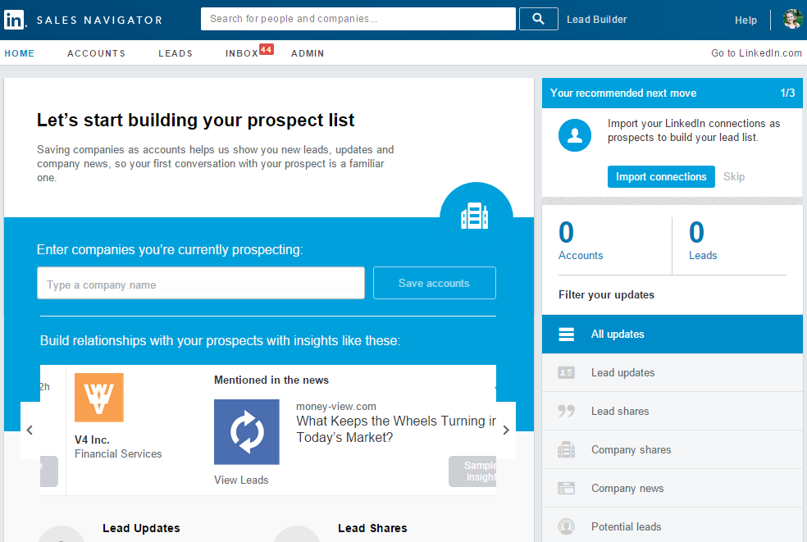

Slide 15
Taking LinkedIn to the next level
Join groups (participate, share, monitor discussions)
Learn about their environment
Projects they have worked on
Recommendations
Sales Updates
Using Keywords in your search
Using Member profiles and account pages to find new leads
Sending effective InMails

Slide 16
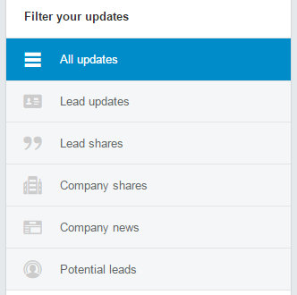
Sales Updates
Lead updates: Be one of the first to know when a lead change roles, has an anniversary, is mentioned in the news, or connects with someone in your network. Leverage these insights to start a conversation with a prospect or keep tabs on what is happening with your existing customers
‪Lead shares: Understand what your leads care about by seeing their professional shares on LinkedIn. Use that information to personalize your communication and strengthen rapport
‪Company shares: Receive key information about your accounts that is posted to their Linkedin.com company page. Take advantage of these insights and incorporate up-to-date company info into your conversations and communications to position yourself as a trusted advisor
‪Company news: See when companies get mentioned in the news to learn what the public is saying about your target accounts. Engage with insights by using this information as an icebreaker or to congratulate an existing customer on a recent achievement
‪Potential leads: Identify new potential contacts or decision-makers when accounts make new key hires. These potential leads match up with your sales preferences and will ensure you identify all the key stakeholders in your targeted accounts

Slide 17
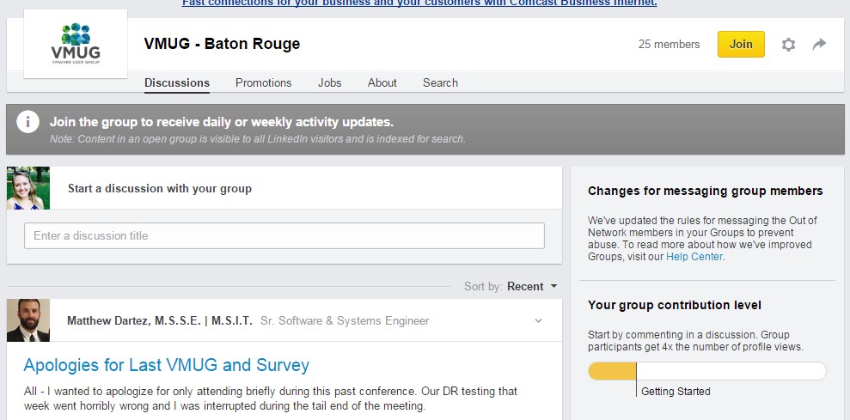
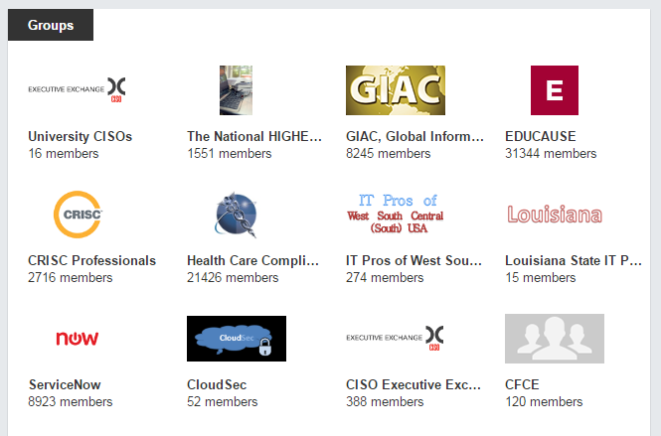
Groups
Notes:
In LinkedIn – under interests and groups – find a group and then type in VMUG

Slide 18
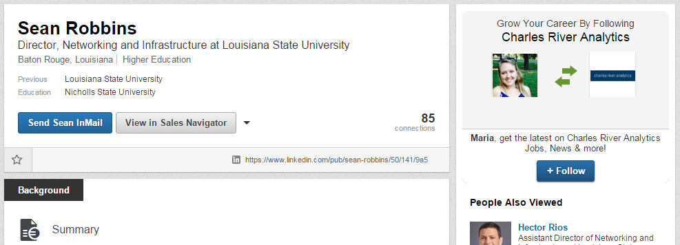
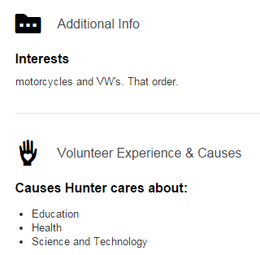
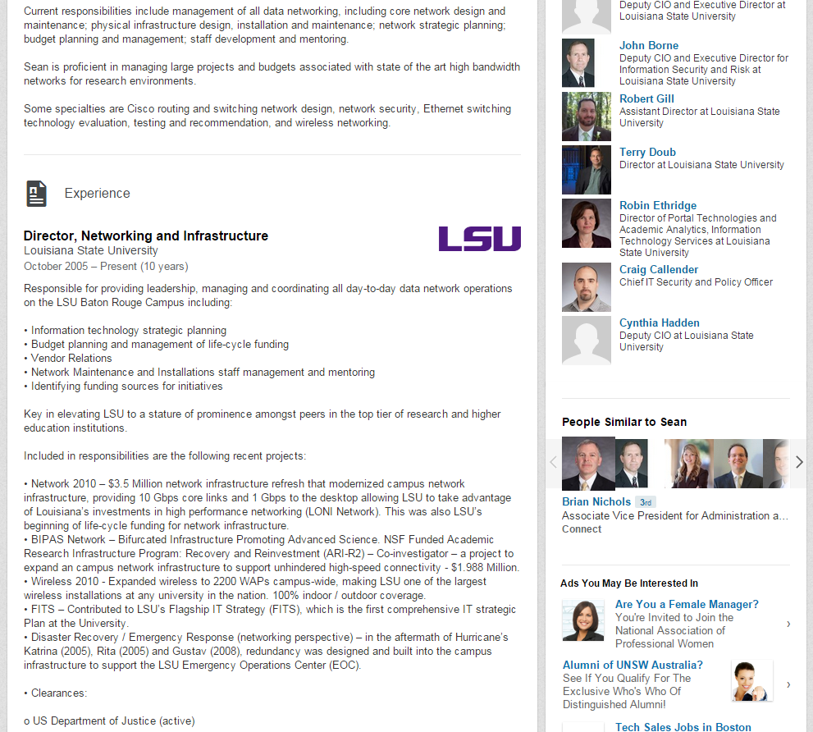
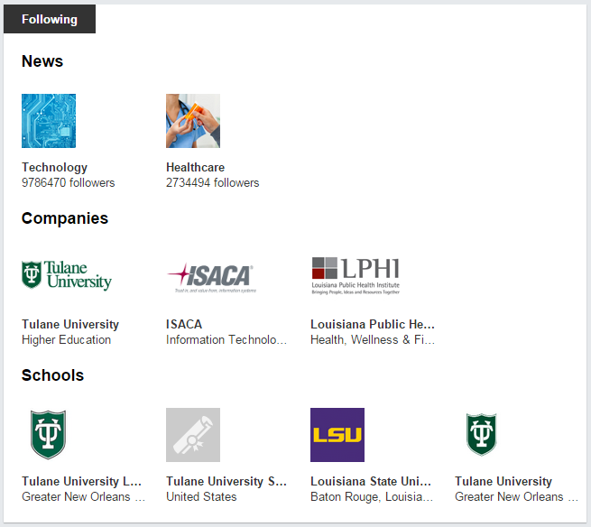

Slide 19
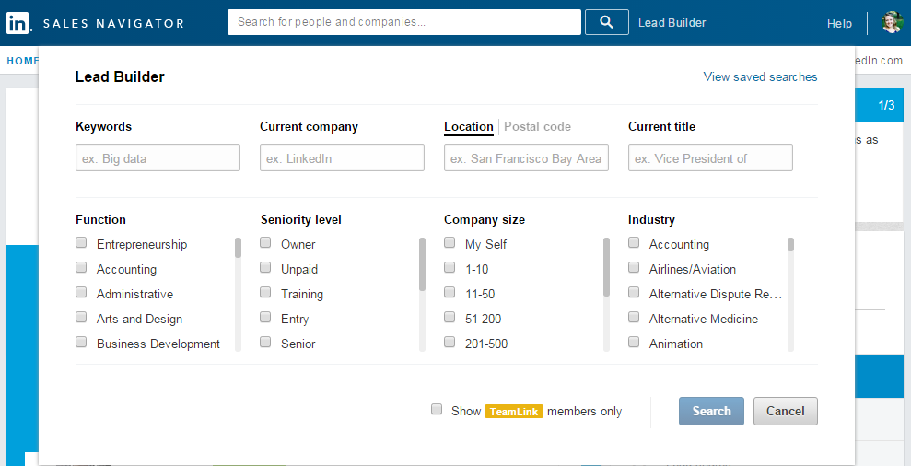
Using Keyword Modifiers in Search
You can build search strings in the Keywords and Title fields using:
AND
OR
NOT
Quotes
Parentheses
Notes:
All about expanding and narrowing your search to find prospects - Keyword modifiers help you find results more closely related to the types of prospects you need to find

Slide 20
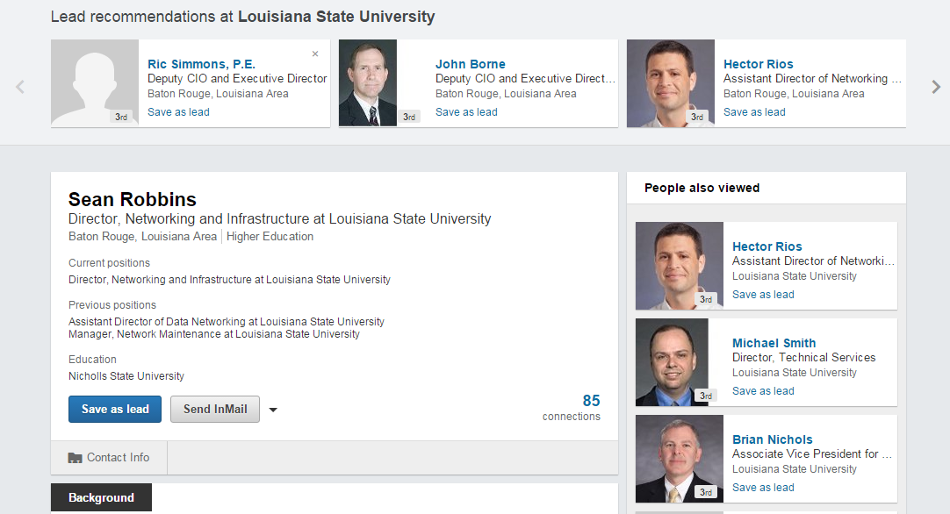
Member Profiles
Lead Recommendations – other members who work at the same company with a similar seniority level in a related organization
People Also Viewed – member profiles that viewers of the current profile looked at, usually have a similar job title or on the same team as the prospect
Account Name – company’s account details page, where you can look for other leads who work at the same company

Slide 21
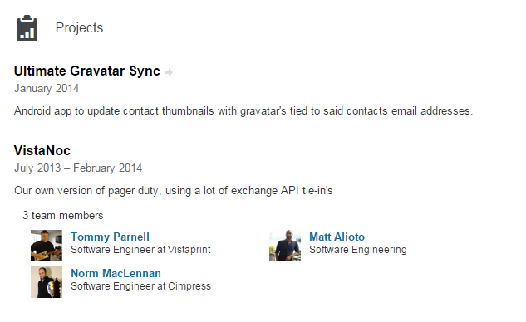
Relevant Projects

Slide 22
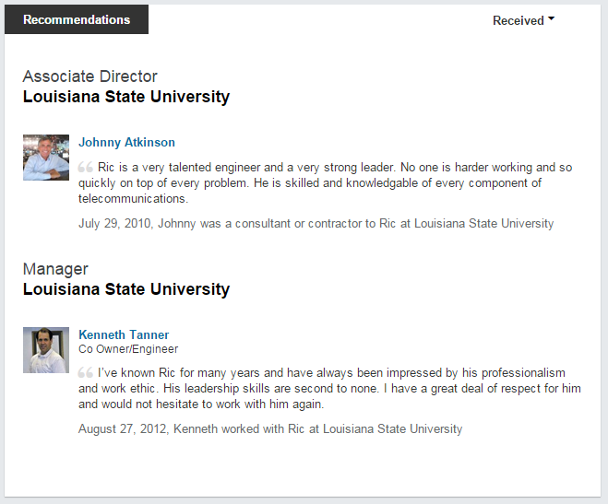
Who is recommending who?

Slide 23
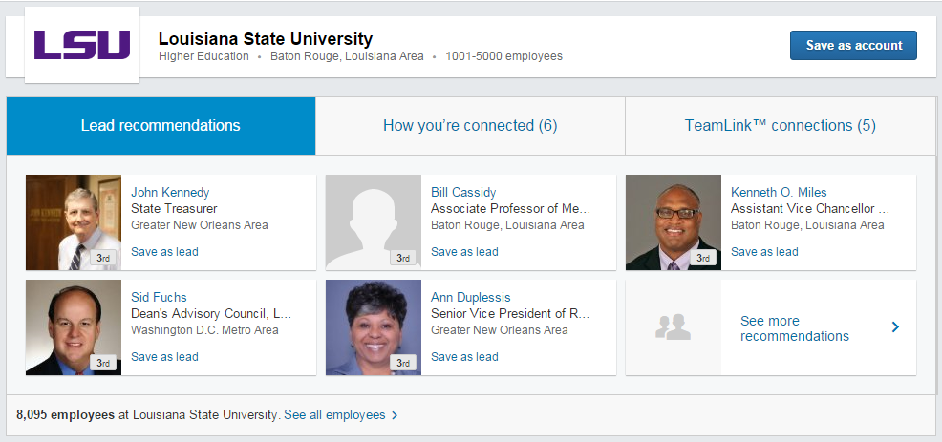
Finding Leads in the Account Page
Lead recommendations on an account details page are different rom Lead recommendations on a member’s profile. Here you’ll see members who work at this company and whose characteristics match the sales preferences you chose during the setup process

Slide 24
Finding Leads in the Account Page
How you’re connected – 2nd degree connections are members with whom you share a 1st degree connection, and you can ask that connection for an introduction

Slide 25
Finding Leads in the Account Page
TeamLink Connections – shows members who work at this company that someone on your team is already directly connected to, so you can ask your team member for an introduction

Slide 26
Engaging with InMail Messages
Focus on quality versus quantity
Compelling subject lines
Personalize your message but brief!
Develop a clear call to action
We’ll discuss this more in Diversified Prospecting – Part 2!
Notes:
How have you guys been using InMail?

Slide 27
DiscoverOrg

Slide 28
We get cold leads from a variety of sources…
Prospecting (LinkedIn, etc.) | List Vendor | Subscription Service: DiscoverOrg
Can be cheap depending on services purchased Very clean data (self-updated) | Can be cheap Leads available in massive quantities Broad company coverage (millions of companies) Data aggregated using crowd sourcing, web scraping, etc. | Very clean data Updated via cold calling so low bad data rate Focus on IT sector Deep information on role, org chart, etc. Direct link to Salesforce
Rarely provides email addresses or phone numbers Company data is limited | Quality is usually bad IT employees switch companies often Data gets stale quickly Very limited information on role (title is not sufficient for our needs) | Expensive Limited account coverage (top ~15K companies in the US/Canada)

Slide 29

What is DiscoverOrg?
Company profile service purchased on subscription
Data aggregated by team of managers who call covered companies every 90 days
Track information on:
Basics (name, title, company)
Company demographics (employees, revenue, IT employees, IT budget)
Org chart
Contact role and technology responsibilities
Company technologies utilized
Direct import link to Salesforce
Notes:
Sf cleanup
LinkedIn prospecting (saves time)
New information

Slide 30
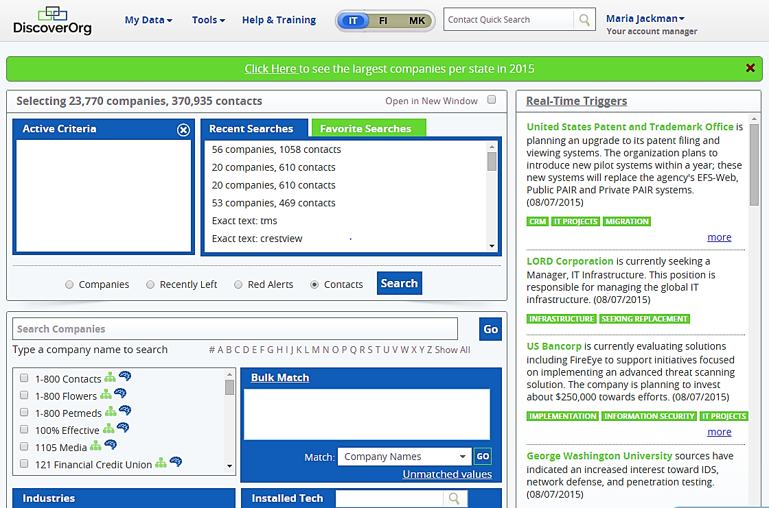
Home page allows users to search companies or contacts based on a variety of variables
Industry
Technologies utilized
Seniority level
Job function
State
Metro area
Area code
Keywords
Etc.

Slide 31
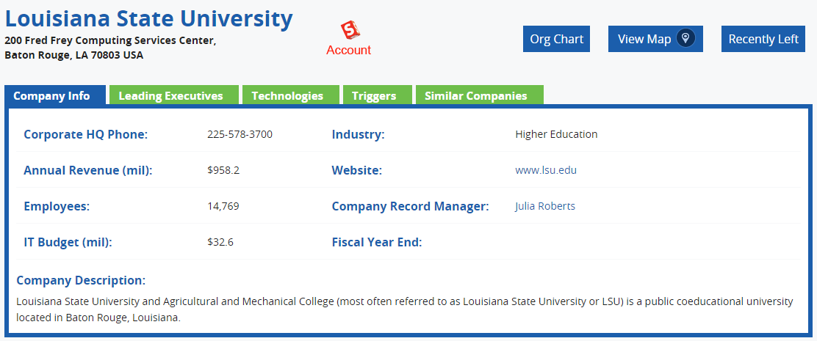
Account View
Notes:
GO THROUGH THE WEBSITE AND GO OVER EACH TAB

Slide 32
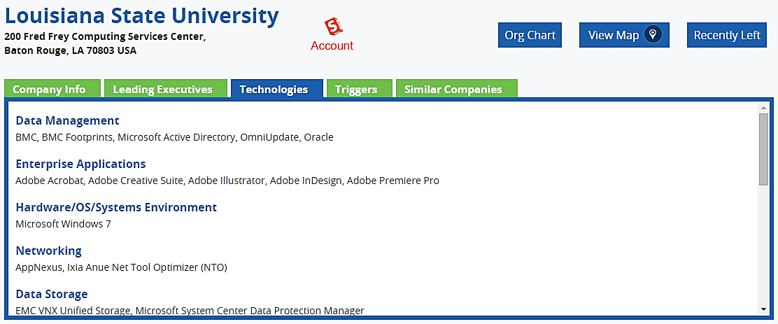
Current Vendor Technologies

Slide 33
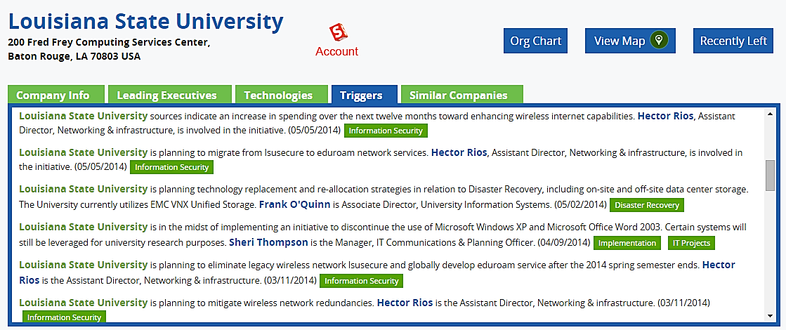
Real-Time Triggers provide email updates on recent CIO moves and current IT projects

Slide 34
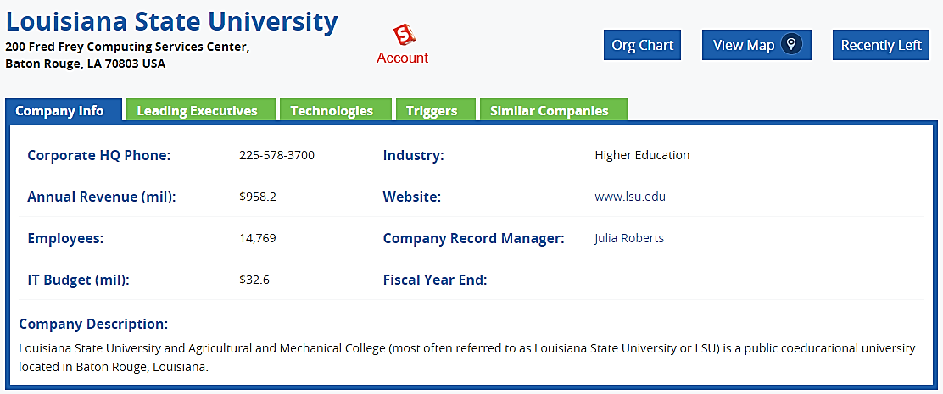
Notes:
GO THROUGH THE WEBSITE AND GO OVER EACH TAB

Slide 35
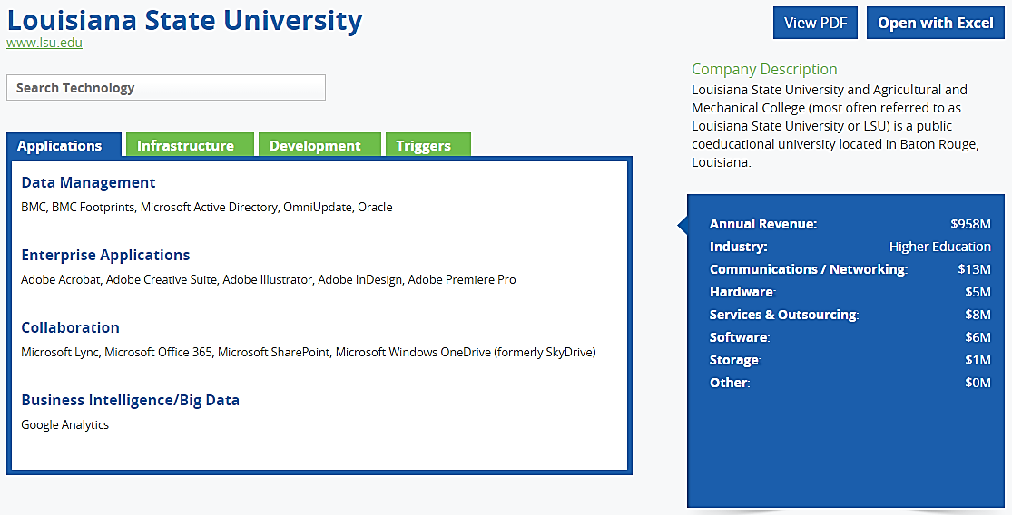
Org Chart gives more detailed information on their IT infrastructure…

Slide 36
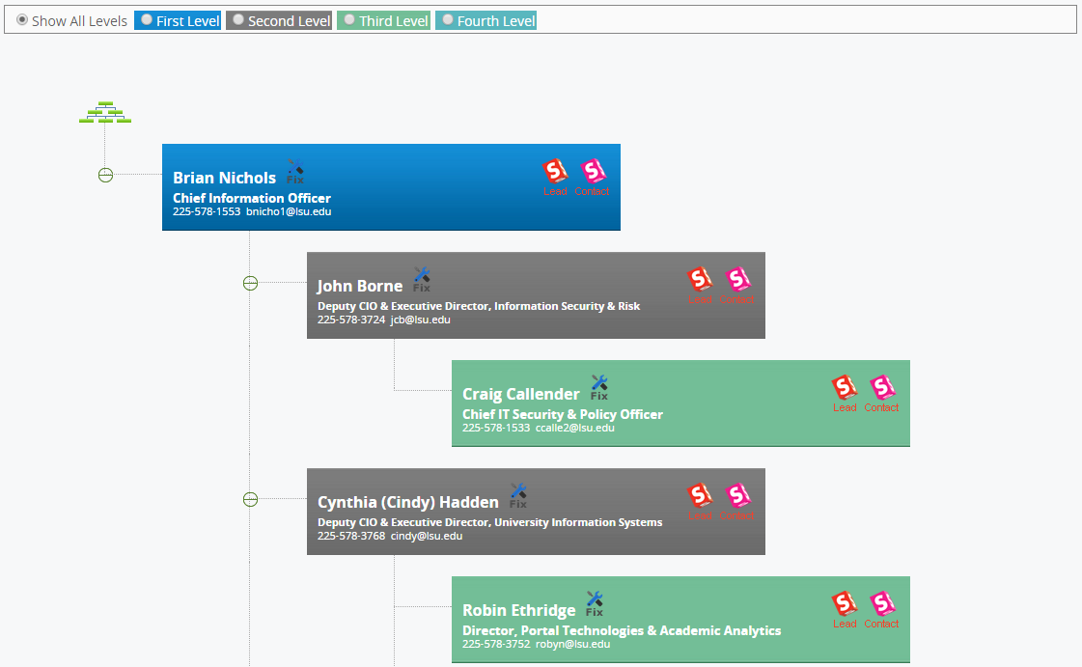
...and indicates who the primary stakeholders are

Slide 37
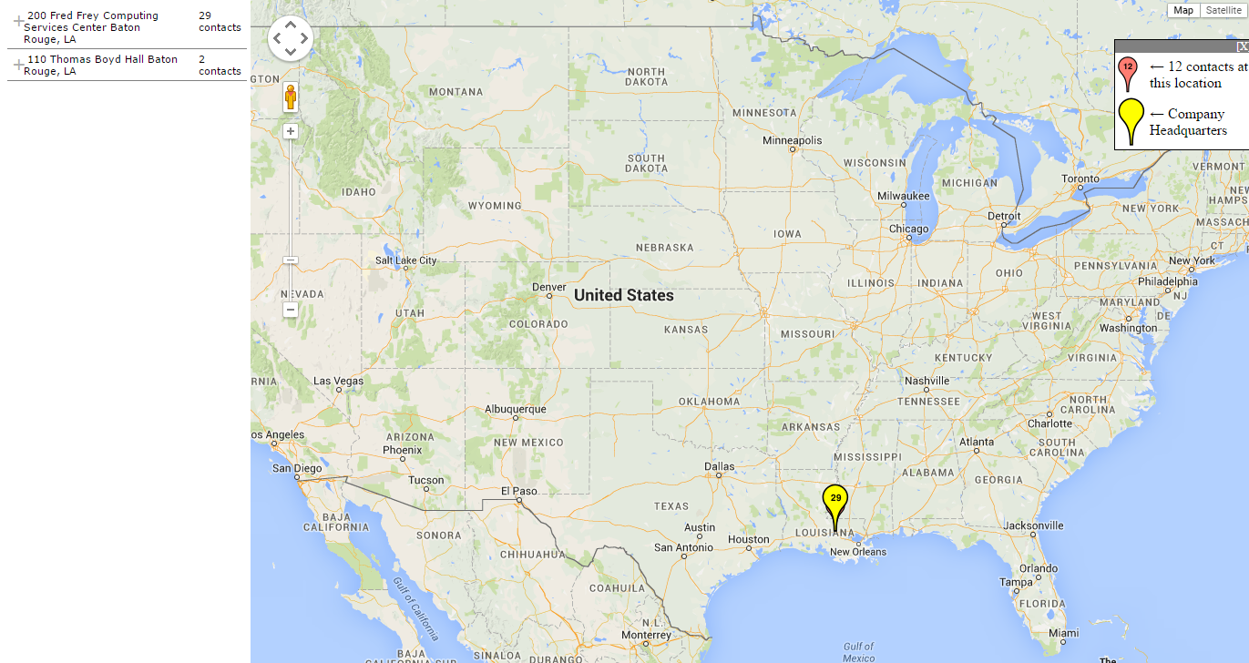
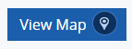

Slide 38
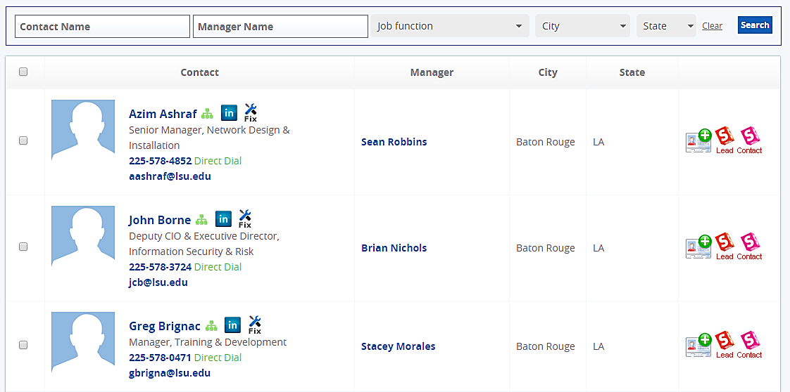
Contacts are listed and can be imported directly into Salesforce

Slide 39
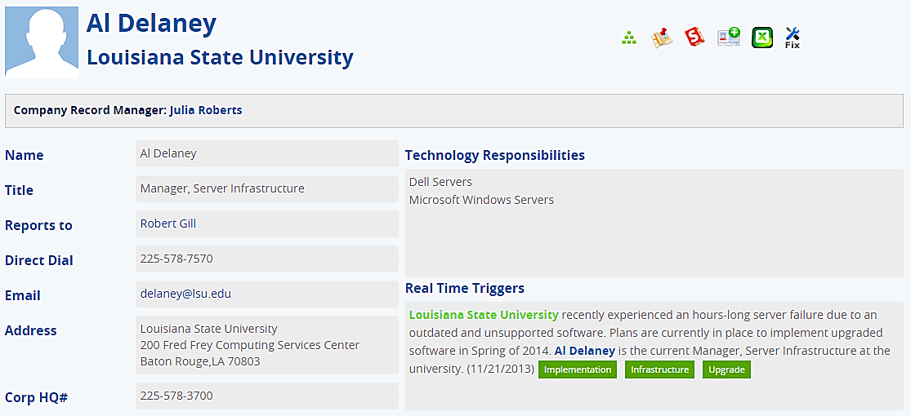
Contact detail pages provide information on role and technology responsibilities

Slide 40
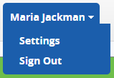
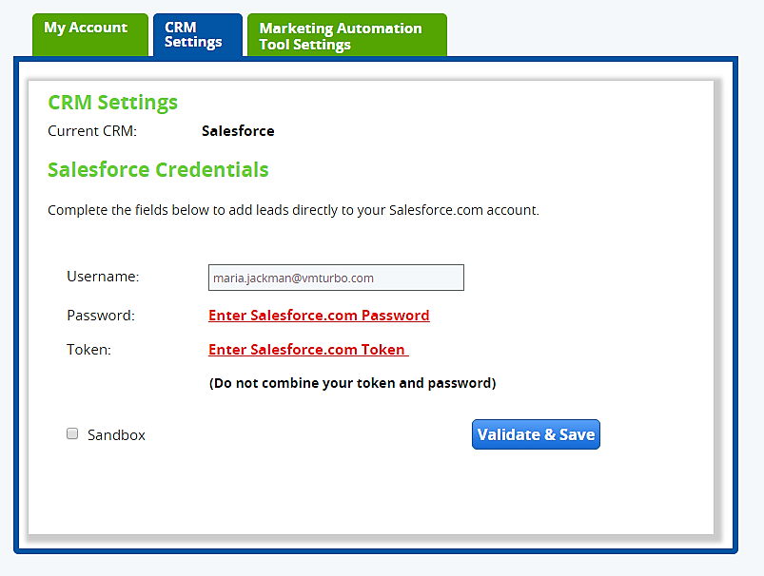
Steps Required to Link SFDC and DiscoverOrg
Log into DiscoverOrg
Hover over your name at the top right of the screen
Click Settings and the CRM Setting tab
If you don’t see the Salesforce Credentials section, we will email our rep at DiscoverOrg to reset your account so you can link to salesforce
Once the account is reset, enter your Salesforce username, Salesforce password, and Salesforce token
- To get your salesforce token, log into salesforce, click your name at the top of the screen, click Setup, My Personal Information, Reset My Security Token, Reset Security Token (your token will be emailed to you)
At the top of the hour, the salesforce import icons should appear in DiscoverOrg

Slide 41
Other Tools For You To Use
Company Website
Google News
Yahoo Finance
Company’s10K
YouTube

